Slide 1
Web 1 WNM 249 – HTML/CSS
Instructor: Yukiko Ishida

Slide 2
First Step in Web Design
Prerequisites:
Design technology
Visual design principles
Web 1
UX 1
Web 2
Responsive design
Javascript
jQuery, Dom manipulation
Web 3
Content management systems
CSS frameworks
Media queries
Notes:
You should have basic software skills like how to use photoshop. We’ll be reinforcing previous concepts within the area of website design. Questions, talk to me after class

Slide 3
What will you learn?
Design and code web sites with multiple pages
Interact with the web systems that provide hosting
Move and manage files on a remote server
Analyze and discuss how web pages are created and displayed in the browser
Notes:
Designing basic sites & Working with files

Slide 4

Denai Avila

Slide 5
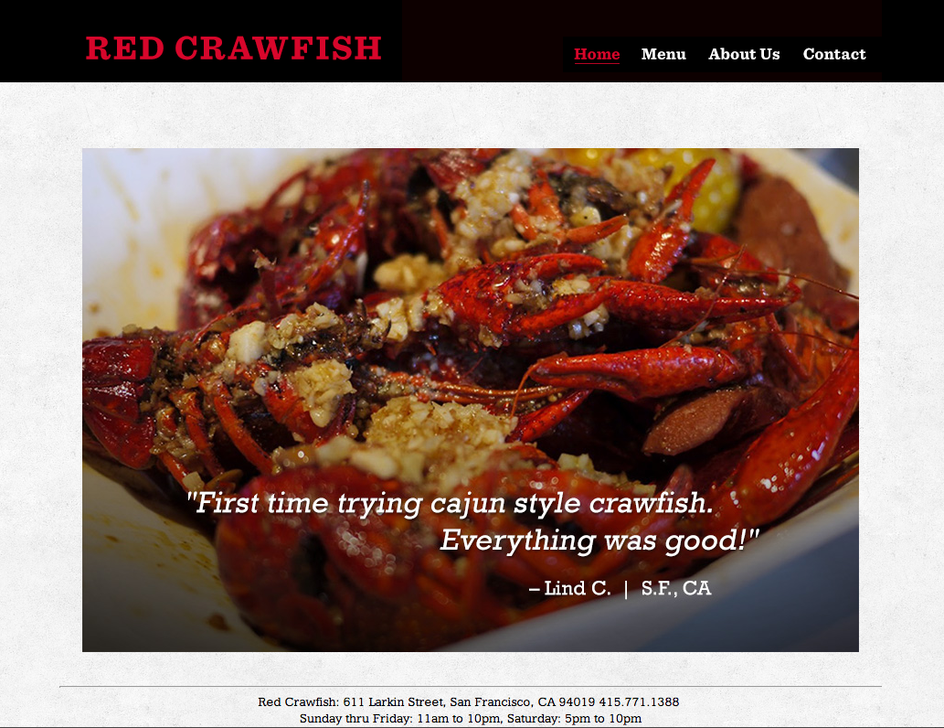
Eric Feng

Slide 6
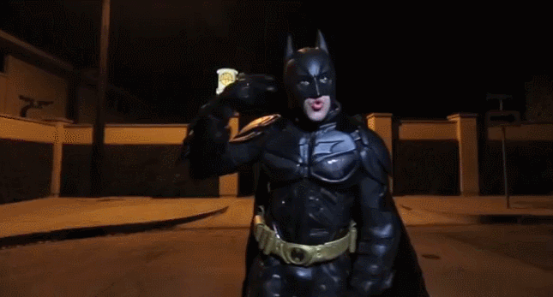
HTML/CSS Ninjas
Write industry standard HTML and CSS
Utilize the core tags that define HTML in original web site designs
Design and code web pages using float, clear and background images
Notes:
Not focusing on software: photoshop illustrator, dreamweaver, fireworks.

Slide 7
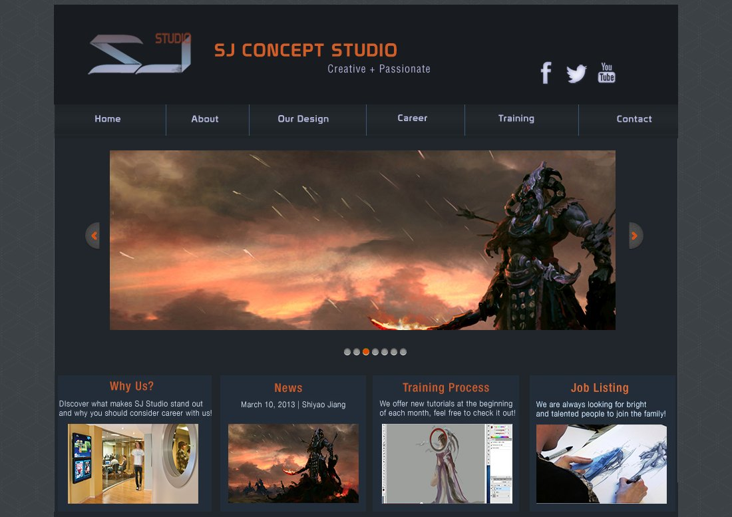
Zihang Jiao

Slide 8

Jessica F.
Jessica F

Slide 9
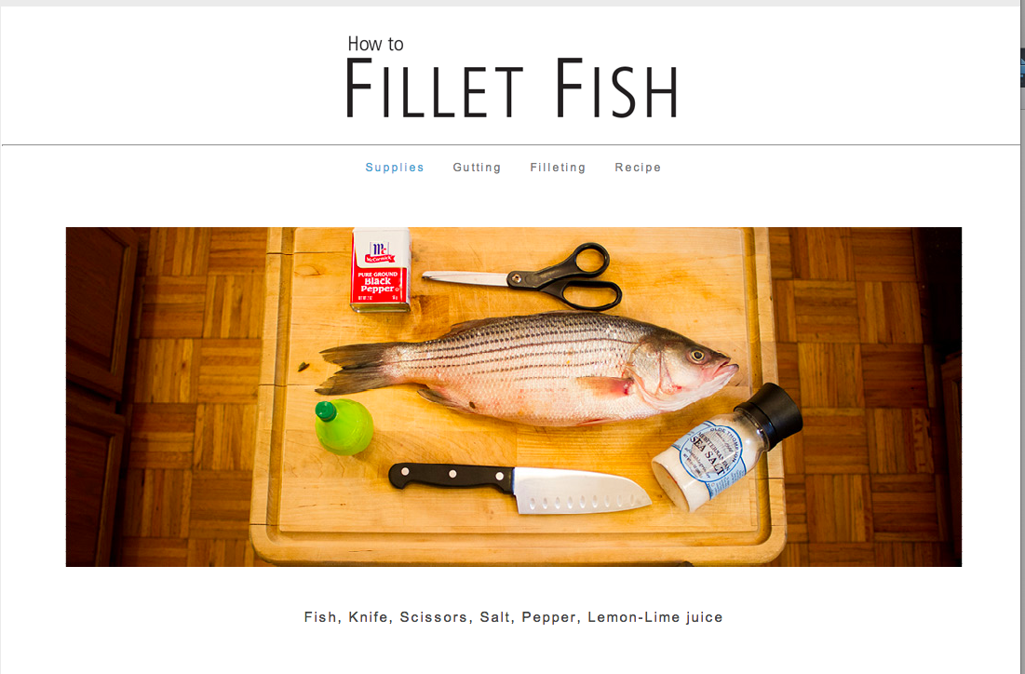
Main Project: Tutorial Site

Slide 10
Supplies & tools
Code editing software (free)
FTP software (free)
Photoshop
Hosting (~$10/mo)
Domain name ($15/yr)
Consistent internet access

Slide 11

Textbook is Optional
HTML and CSS: Design and Build Websites
John Duckett

Slide 12
Important links
Class Website
web1.yukikodesign.com
Email
Yukiko.ishida.aau@gmail.com

Slide 13
Questions?
Notes:
About content of the class?
If unsure if class is right for you, we can talk during break

Slide 14
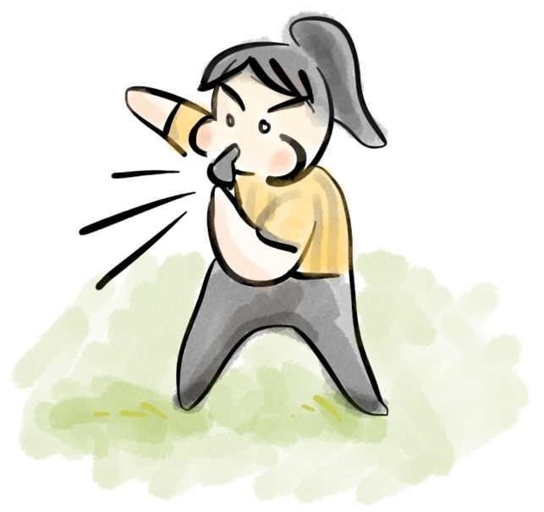
Class Rules
Work & Grading
Plagiarism
Time Management

Slide 15
Attendance is Mandatory
7:10pm - 10pm SHARP
Word of the day for on-time students
All info on class website (No make-up classes, notes)
If sick/absent, homework still due
“Don't miss class, you will get behind very fast.” -DA

Slide 16
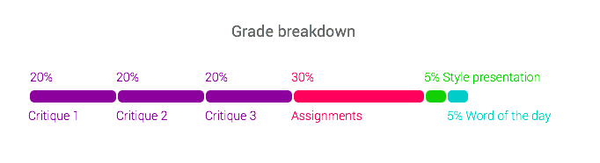
Grading is Impartial
Want to see consistent progress, participation in class
No excuses! Parents, GPA, Financial aid

Slide 17
Critiques
3 critiques
Must present work for critique grade
Must participate and give feedback to others
Notes:
Expectation that critique is like meeting a client. If you miss it, you don’t get paid

Slide 18

Late Work
-20% grade deduction
Up to 2 weeks late only!
Must email teacher with assignment #

Slide 19
Sick / Absence
Please email me
If sick, need to see doctor’s note
Still need to turn in assignment online
Look at class website for missed materials

Slide 20
No Plagiarism
You must create your own content!
Photos, illustrations – cite stock
Pick assignment topic that you can create content for
Code needs to be modified substantially for own use, commented

Slide 21
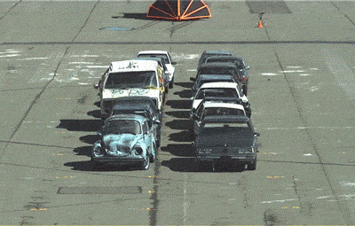
Get Ready! This class is non-stop!
Notes:
Fast paced class!
Steep learning curve
Organization & details matter
Like learning a language

Slide 22
Actively seek help
Ask for help in class
Email me- I am happy to respond
WNM Workshops TBD
ARC (Academy Resource Center) 1-on-1 Tutoring

Slide 23
Questions?
Notes:
About content of the class?
If unsure if class is right for you, we can talk during break

